Slide 1
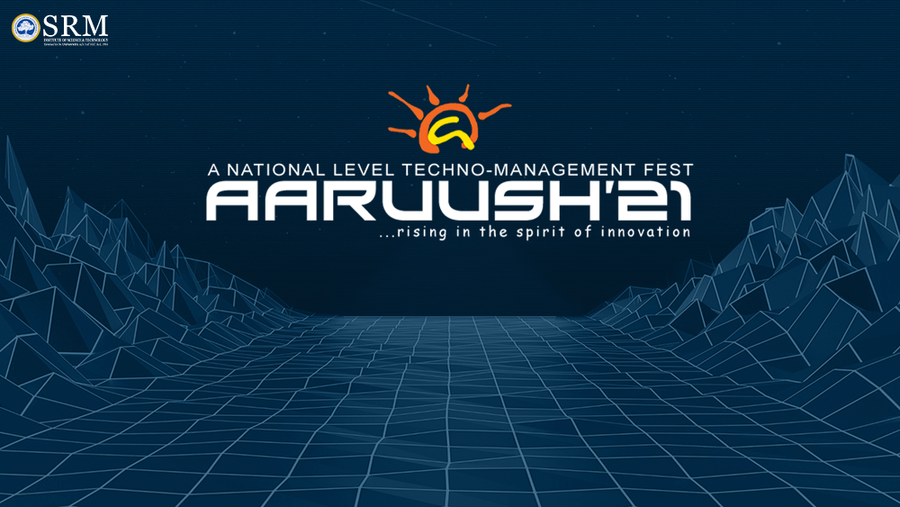

Slide 2
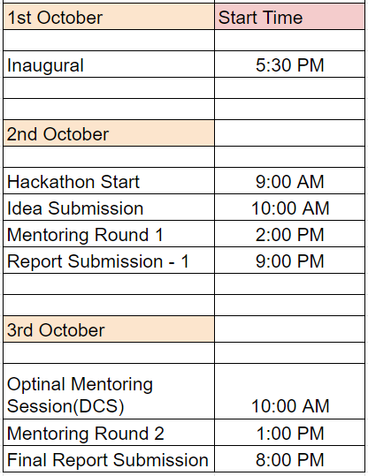
EVENT FLOW
*THIS SLIDE CAN BE DELETED DURING SUBMISSION. THIS SLIDE IS ONLY FOR REFERENCE

Slide 3
Team Name:
LUCY`S EXPLORATION
Team Members:
Koushiki Chakrabarti
College Name: Birla Institute Of Technology ,Mesra
Graduating Year:2025
Shreya Sharma(Leader)
College Name: Birla Institute Of Technology ,Mesra
Graduating Year:2025

Slide 4
Topic:
Artfully Illuminated Asteroid
Overview:
Through our project, we have tried to explain and create awareness about asteroids and lucy`s upcoming mission. We have used unity 3D software to built a virtual reality museum. As it is a 3D model ,it seems interesting to anybody and helps in creating awareness in a fun way.
Project Idea:
Dynamic models are deployed in the virtual museum. Initially one gets to know about asteroids and trojan asteroids. That is followed by types of asteroids and different kinds of models involving ‘Lucy’. At last, we concluded with some important key points that are somehow related to the mission.
*Virtual Reality:
Virtual Reality (VR) is a computer-generated environment with scenes and objects that appear to be real, making the user feel they are immersed in their surroundings. It gives 3-D view too.

Slide 5
FUTURE ENHANCEMENTS
SO, HOW IS YOUR SOLUTION DIFFERENT?
The main and the most important point is that it is 3-D.It consists of .gifs ,videos ,pictures and articles making it more engaging .
At the same time , it consists of enough information regarding asteroids and trojan asteroids involved in ‘Lucy’s’ mission that it creates awareness irrespective of age and amount of knowledge one has about it.
Moreover, it is a gaming environment where one can navigate inside the museum using arrow keys(Having a VR headset is a plus point for the person navigating through the museum).
We will be trying to add original audio files explaining each article in our slides making it more easy to understand.
We are trying to add a 3-D model of asteroid in the museum with regular shape and rough surface.
We are trying to make the appearance of museum look more relatable to space and asteroids.

Slide 6
SUBMISSION LINKS
GitHub Link- https://github.com/kc2409/NASA-HACKATHON.git

Slide 7
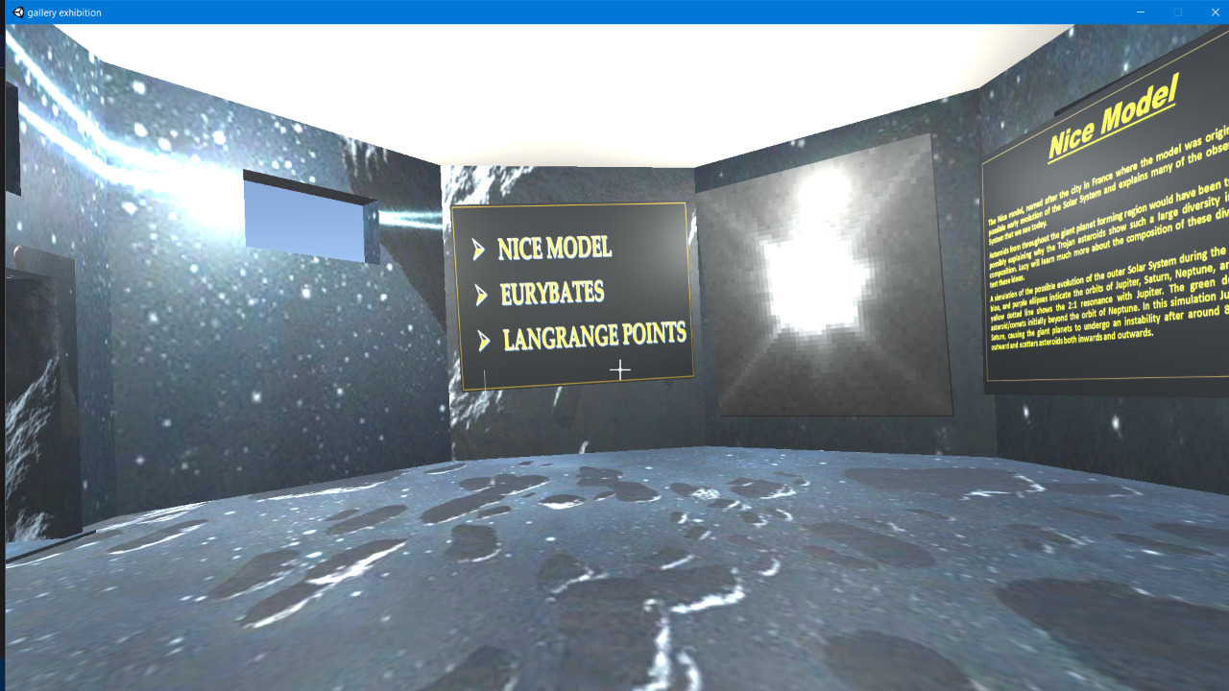
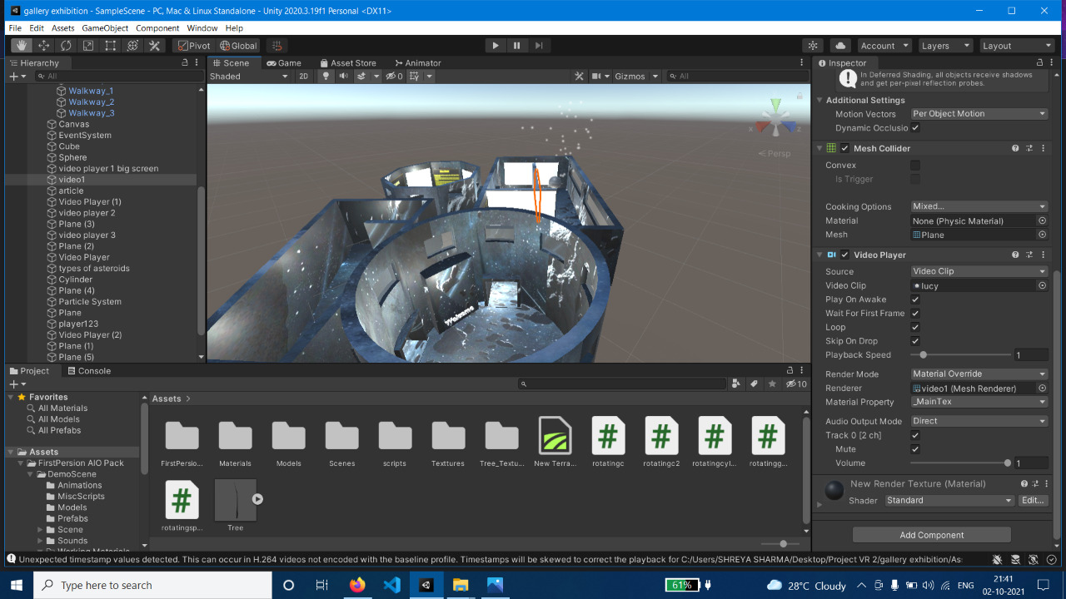
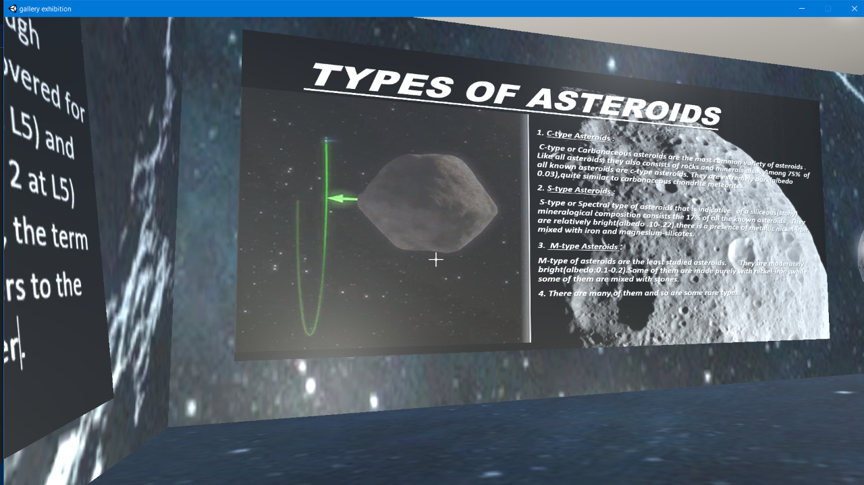
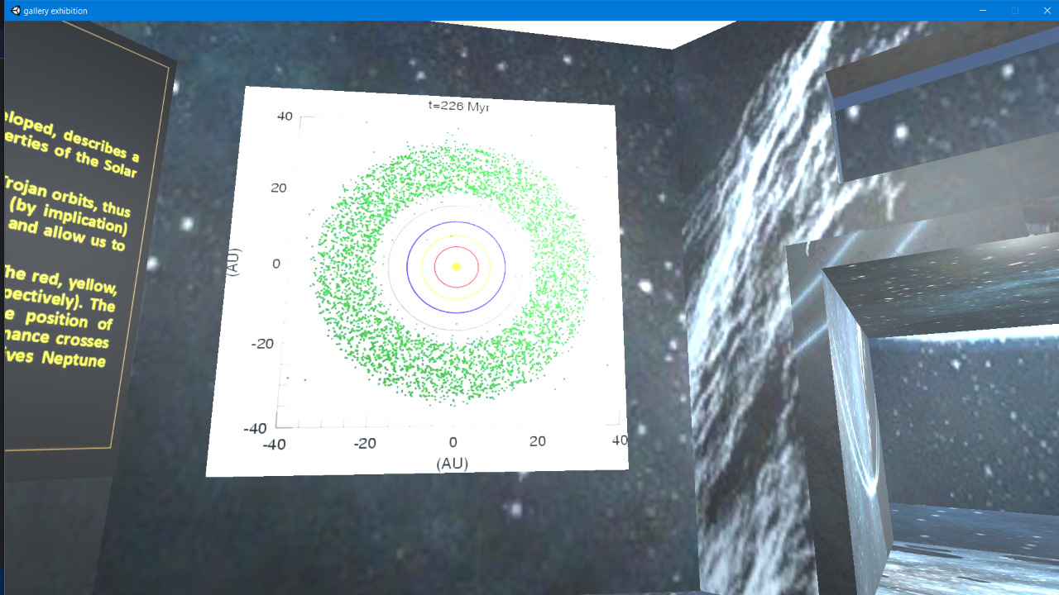
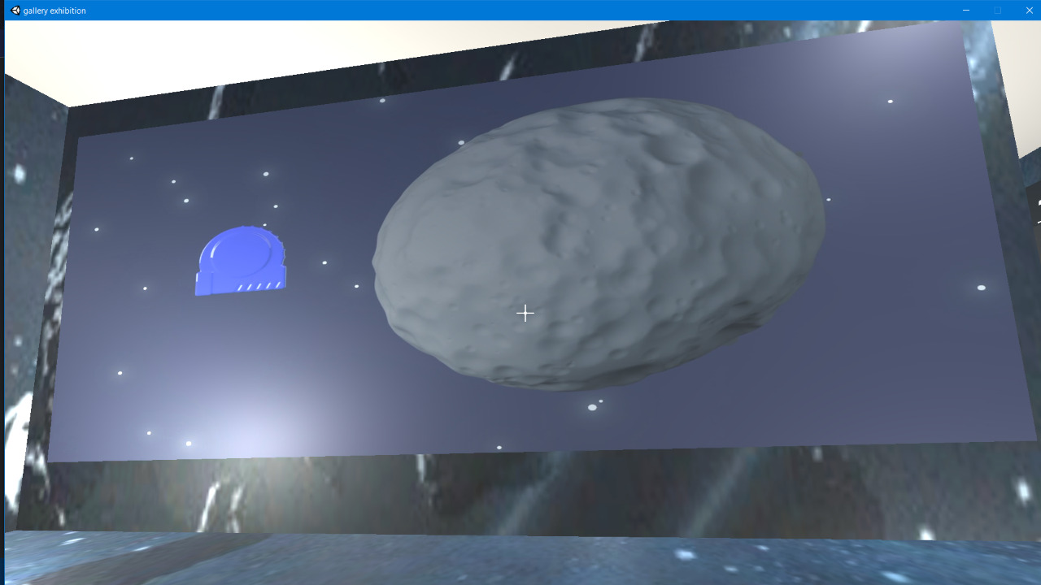
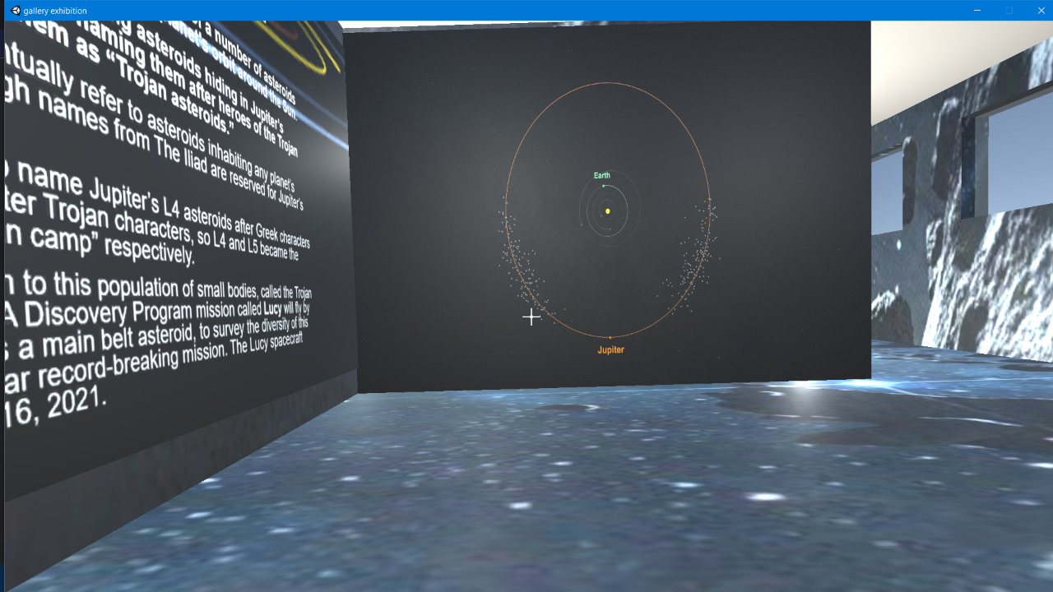
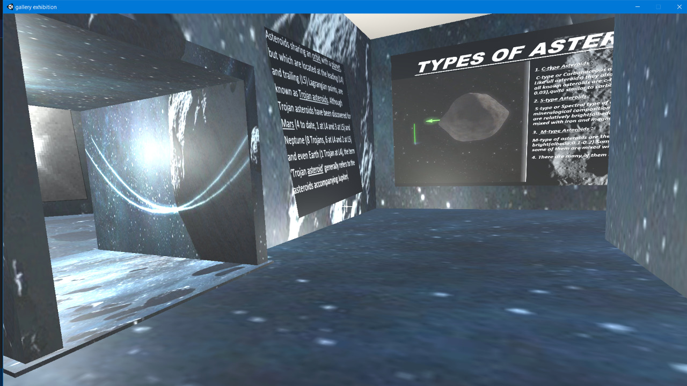
ANYTHING ELSE ?
I would like to share some sample pictures of our project.

